Slide 1
Session 3 Overview
1
This session has 3 main sections:
Bonus Pay – Collect money in virtual environments
Finding the Trophy – Find the trophy as quickly as you can
Questionnaire – Answer some questions about you and your experience in the experiment
Please make sure to listen to each instruction carefully and wait for the experimenter to instruct you to proceed to the next instruction.
Don’t be afraid to ask questions if you need clarification!
Do you have any questions?

Slide 2
Session 3 Overview
2
This session has 3 main sections:
Bonus Pay – Collect money in virtual environments
Finding the Trophy – Find the trophy as quickly as you can
Questionnaire – Answer some questions about you and your experience in the experiment
Please make sure to listen to each instruction carefully and wait for the experimenter to instruct you to proceed to the next instruction.
Don’t be afraid to ask questions if you need clarification!
Do you have any questions?

Slide 3

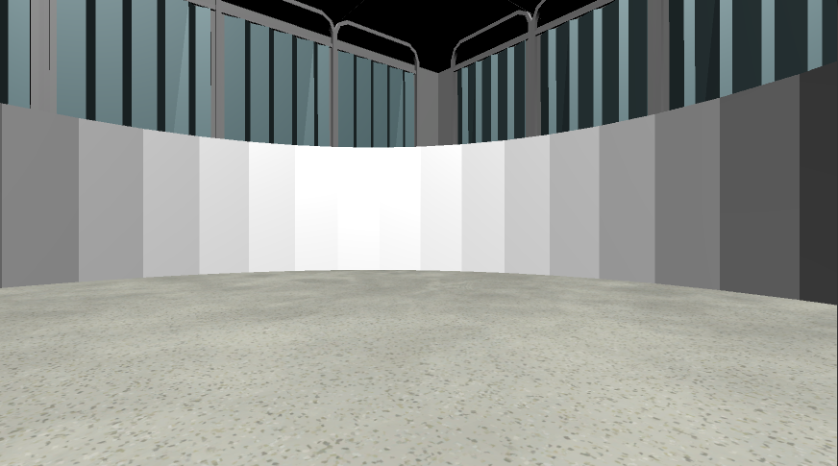
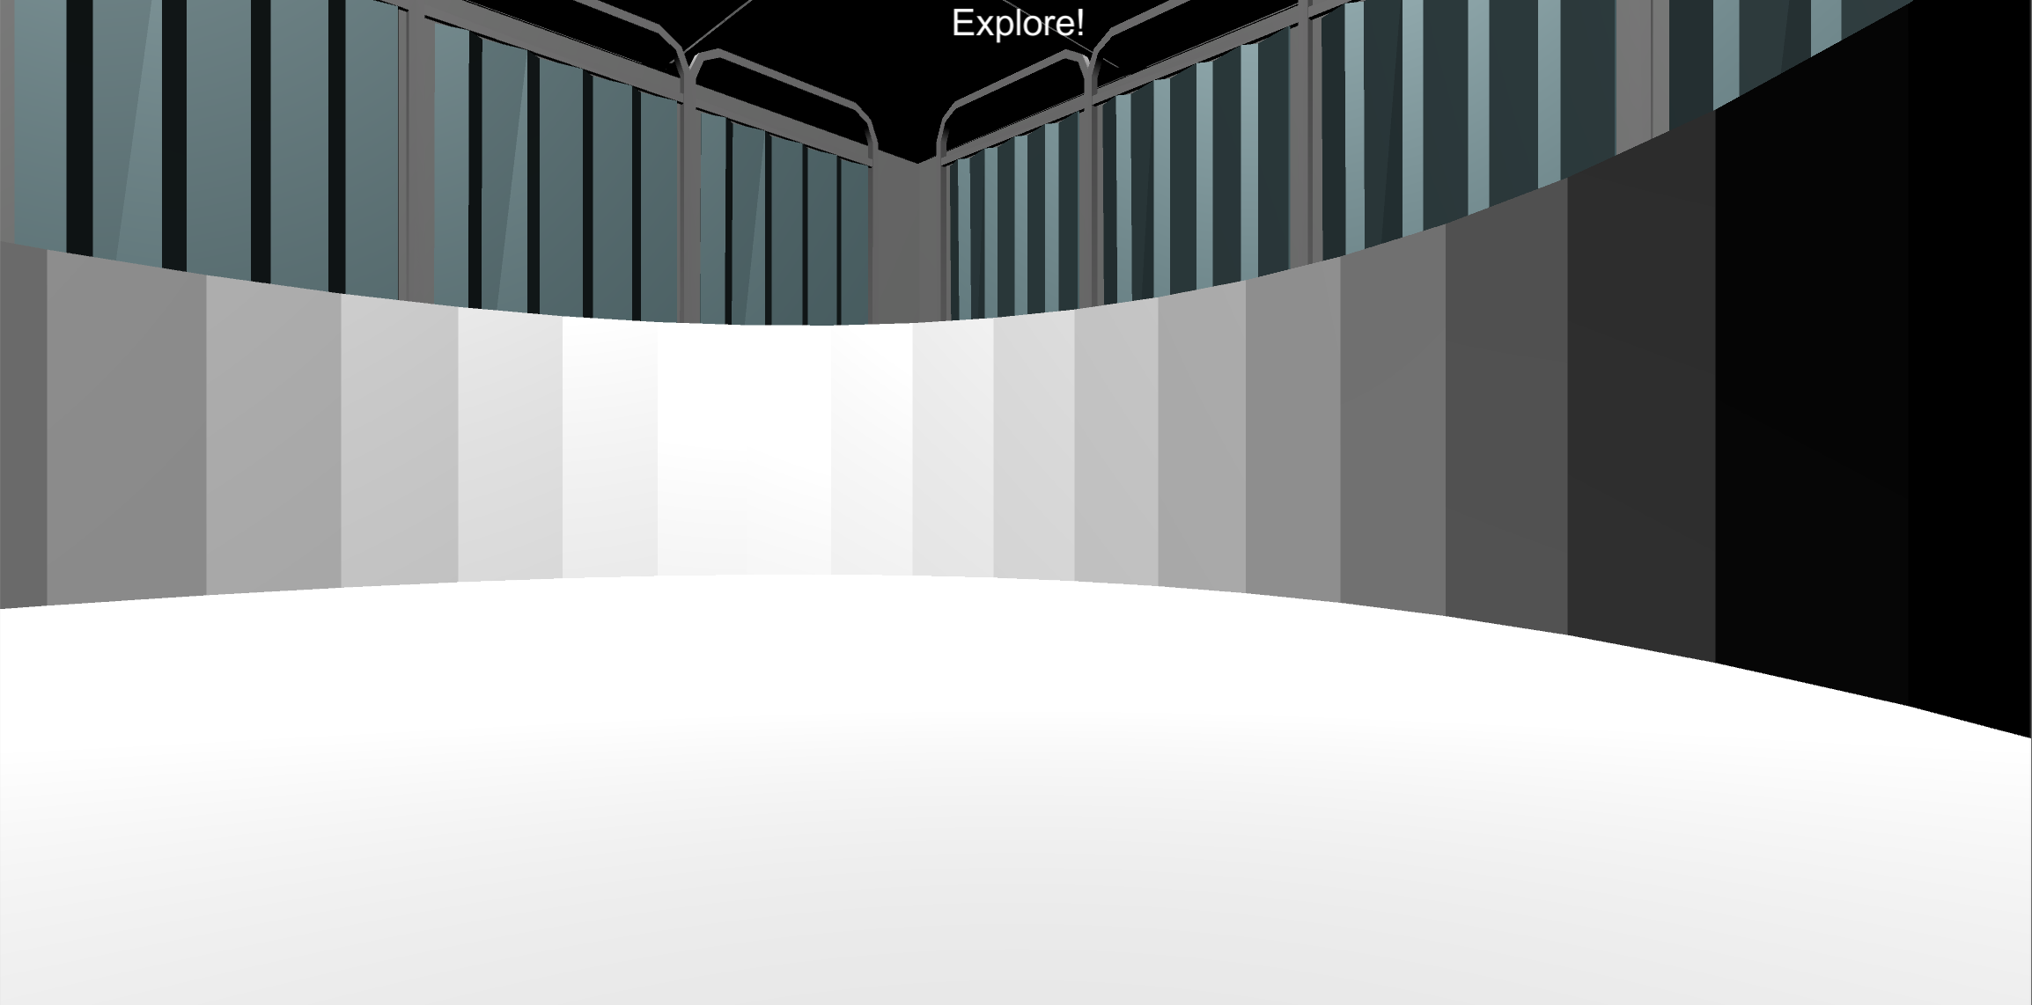

Bonus Pay
Your first task is to collect as much as possible in each of the following Money Collection Rounds. On each round, you will be placed into one of the environments that you learned in the previous sessions Once in the environment you will have 1-minute to collect as much money as possible!!
1 Minute
Do you have any questions?

Slide 4
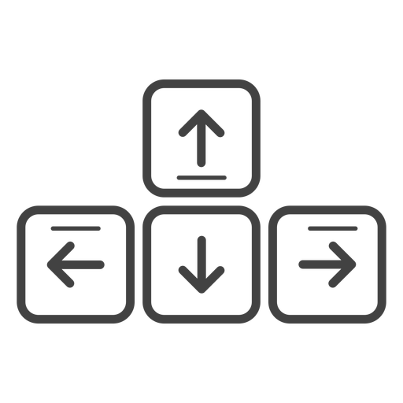
MOVEMENT CONTROLS
The controls are the same as previous sessions: use the Up-Arrow to move forward, and the left and right arrow-keys to rotate.
Move Forward
Rotate
Left
Rotate
Right
Do you have any questions?

Slide 5
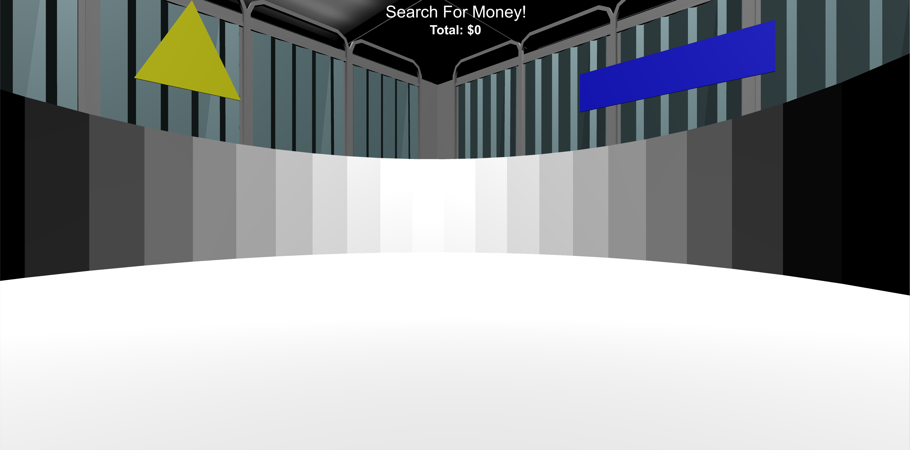

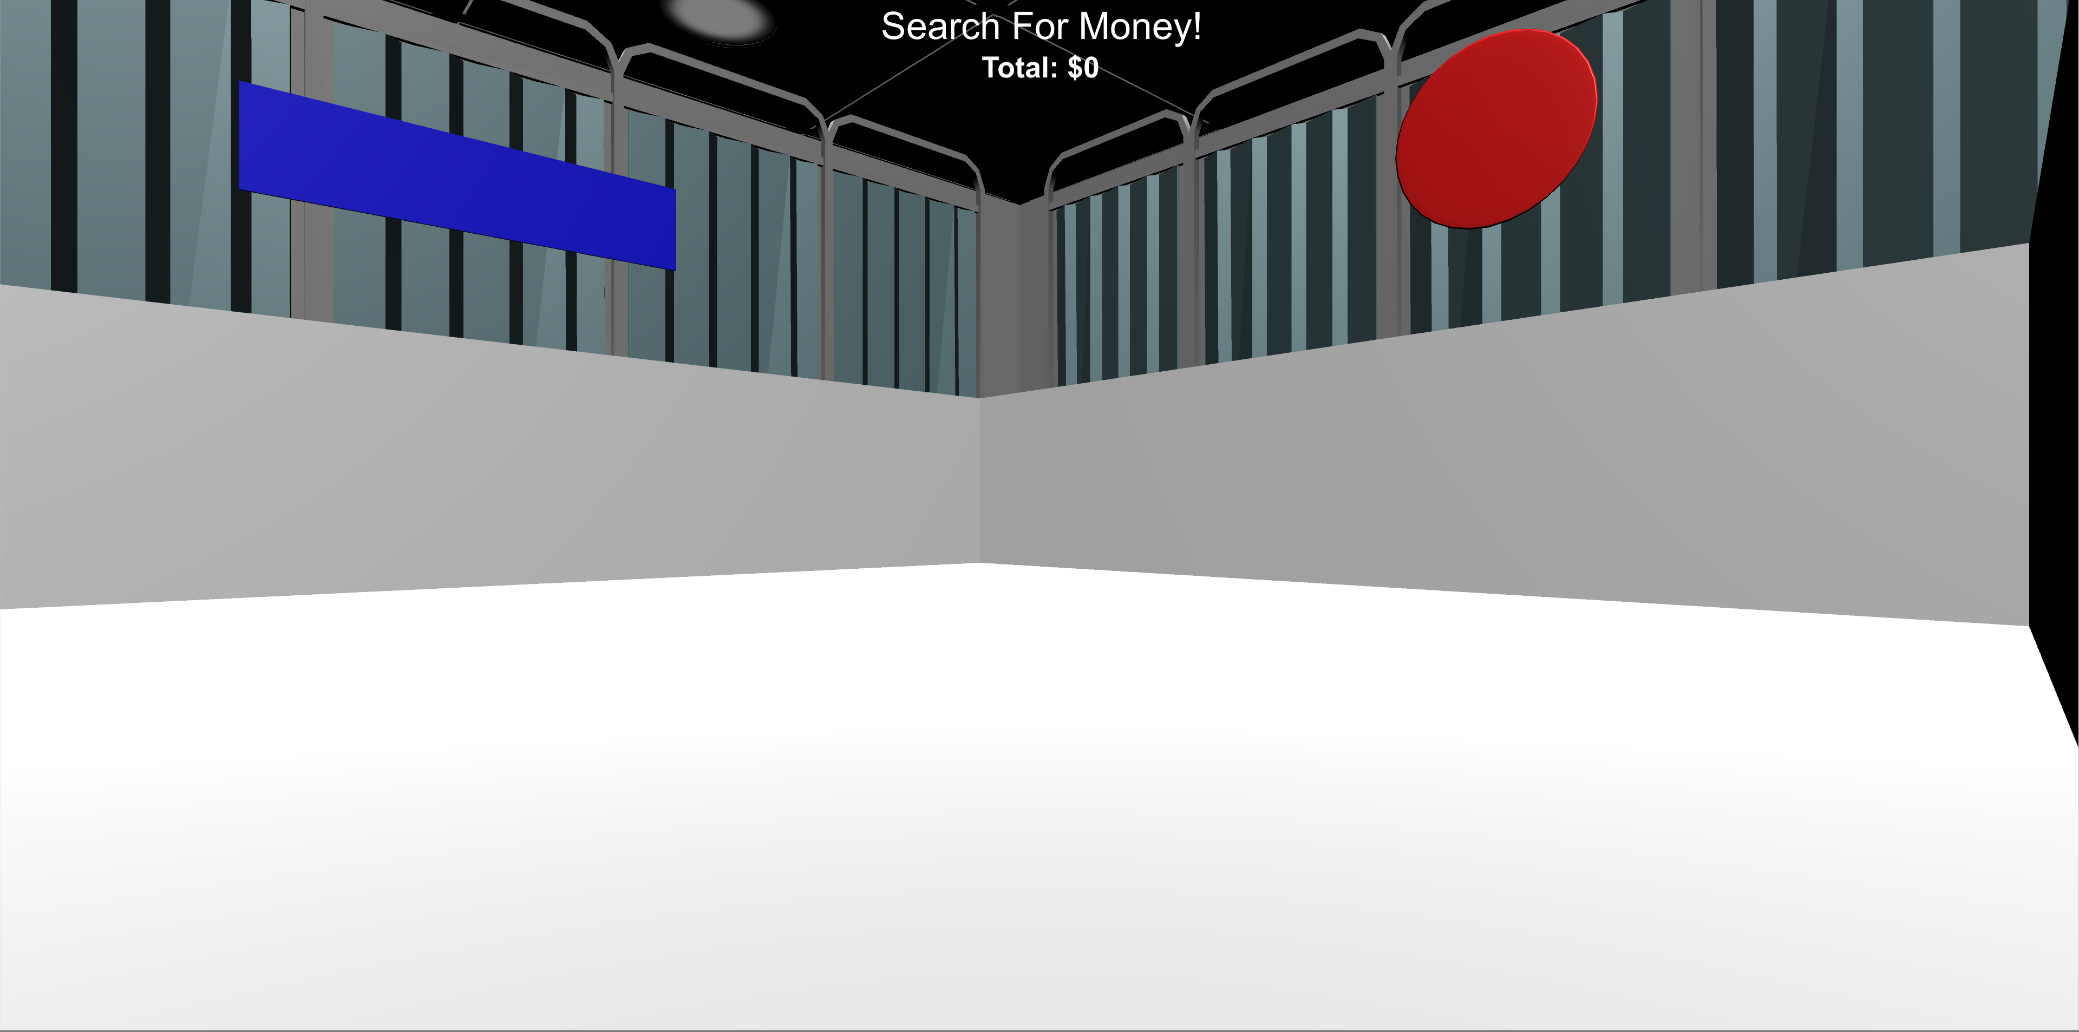
MONEY COLLECTION ROUNDS
All rounds are No Feedback Rounds: no sound and no money collected!
You will see the “Search For Money! NO FEEDBACK” screen before being placed into the environment. Once in the environment you will have 1 minute to collect as much money as possible! You won‘t find out how much you’ve collected until the end of this session!
Do you have any questions?

Slide 6
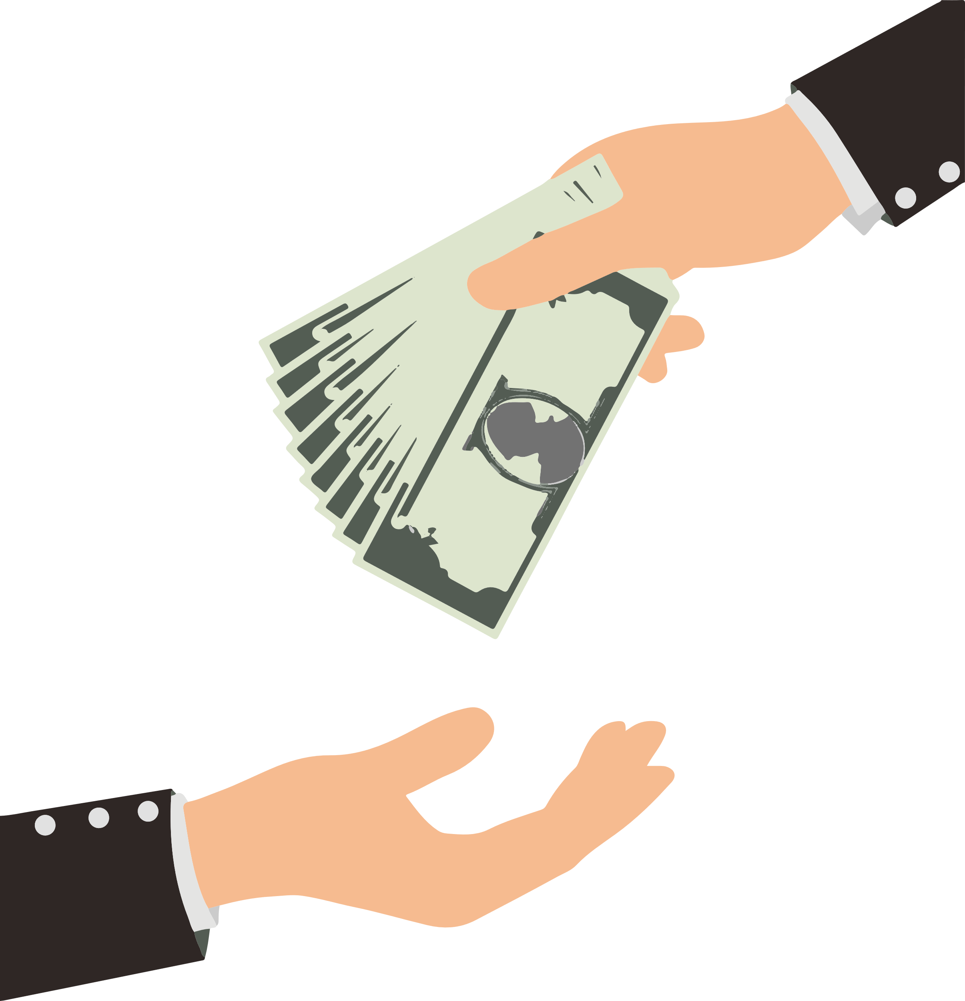
BONUS PAYMENT
There is an UNLIMITED amount of money to collect in each round and any money you collect you will receive as a BONUS PAYMENT at the end of the experiment!
Same as before, you will need collect at least 10¢ to have the money added to your final bonus.
Do you have any questions?

Slide 7
HINT!!
Use what you’ve learned from previous sessions to guide your search!

Slide 8
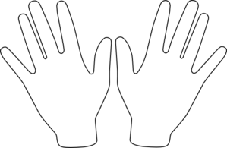
Ready?
When you’re ready, place your right hand on the arrow keys and press the Spacebar with your left to continue!
Spacebar

Slide 9
Great Work!
Notify the Experimenter that you’ve completed this section

Slide 10
VARIATION COLLECTION ROUNDS
In the next part, you will be placed in several environments including variations of the environments that you have collected money in. Your task is to collect as much money as you can in each environment.
Same as in the previous part, you will have 1 minute in each round. You won’t find out how much you’ve collected until the end of the experiment!
HINT: Use what you previously learned to guide your search!
Do you have any questions?

Slide 11
Great job!
You’ve completed the first task!
PLEASE NOTIFY THE EXPERIMENTER!!!
let’s move on to the FIND THE TROPHY section!
Bonus Pay
Find the Trophy
Questionnaire

Slide 12
Great job!
You have only one questionnaire to complete!
PLEASE NOTIFY THE EXPERIMENTER

Slide 14
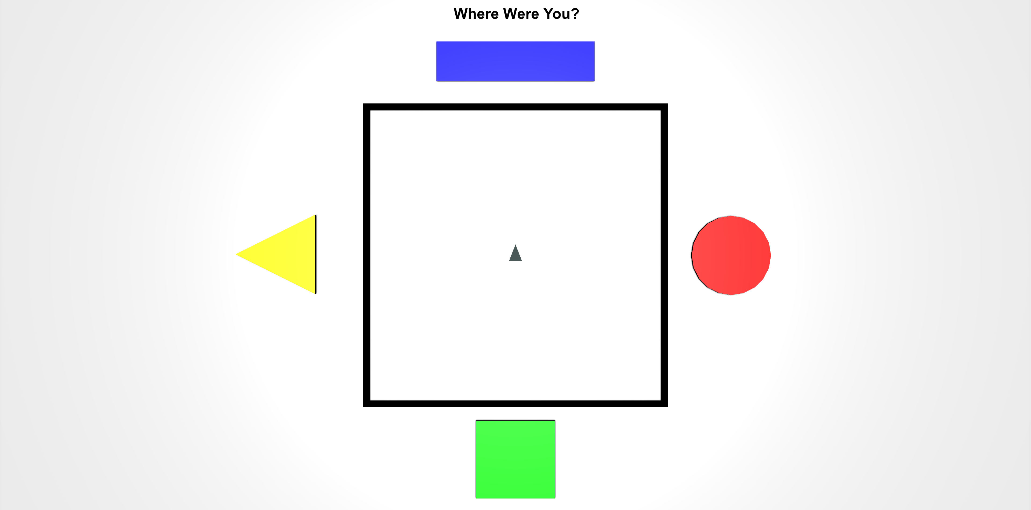
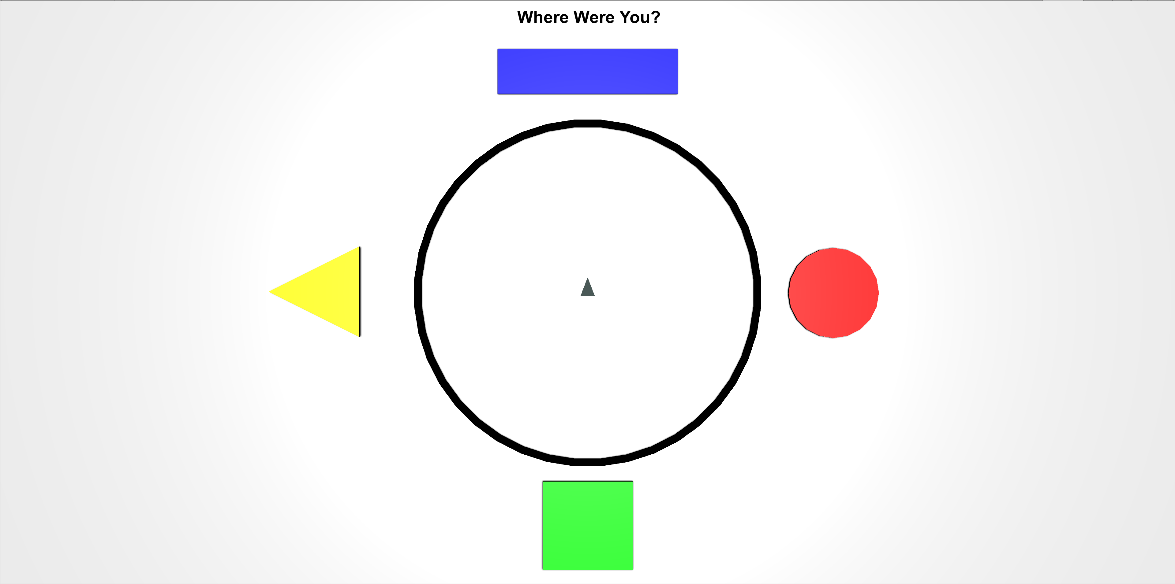
While refamiliarizing yourself with the environments, you will be asked periodically to locate your position from a top-down viewpoint like the ones pictured below.
The grey triangle in the middle shows the direction that you’re facing, and the controls are the same as the 3D environment. Move the grey triangle to the last position you were in, in the 3D environment and then press the Spacebar.

Slide 15
NO FEEDBACK ROUNDS
Unlike previous sessions, ALL rounds in this session are NO FEEDBACK rounds!
At the start of every round “Search For Money! NO FEEDBACK” screen.
During these rounds you will NOT hear a coin sound when you collect money and you will NOT be able to see how much you’ve collected!
Less than 10¢
10¢ or more
Search For Money!
No Feedback Round
Search For Money!
No Feedback Round
When you reach 10¢ the text will not change color and will remain Red. This means that you will not know whether you have collected more than 10¢. However, if you do collect more than 10¢ by the end of the round the money will be added to your Total Bonus Payment.
HINT: Use what you’ve learned from the Feedback Rounds to guide your search!
Do you have any questions?

